Slide 1
Design and Analysis of Algorithms Lab
Dr. Sujata Joshi

Slide 2
Part A
1. Digital maps, unlike humans, see cities as a bunch of nodes. We (humans) consider this map as a single entity. a GPS navigation or any other digital map divides it into hundreds of segments, with some only 24 meters long. A map displays n cities and their distances. Design and develop a program in C to print all the cities reachable from a given starting city in a digraph by using BFS method. Repeat the experiment for different values of n and plot a graph of the time taken versus n(n=no of nodes)

Slide 3
Breadth first search
Breadth-first search is a traversal and it proceeds in a concentric manner by visiting first all the vertices that are adjacent to a starting vertex, then all unvisited vertices two edges apart from it, and so on, until all the vertices in the same connected component as the starting vertex are visited.
If there still remain unvisited vertices, the algorithm has to be restarted at an arbitrary vertex of another connected component of the graph.
It is convenient to use a queue to trace the operation of breadth-first search.

Slide 4
The queue is initialized with the traversal’s starting vertex, which is marked as visited. On each iteration, the algorithm identifies all unvisited vertices that are adjacent to the front vertex, marks them as visited, and adds them to the queue; after that, the front vertex is removed from the queue.

Slide 5
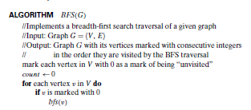
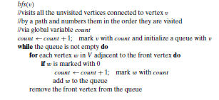
Breadth First Search

Slide 6
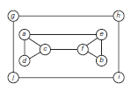
BFS traversal
Nodes : a,c,d,e,f,b g.h,j,i
Edges : ac, ad, ae,cf,eb gh, gj. hi

Slide 7
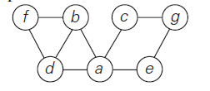
BFS Traversal -
Queue :,
Nodes a1, b2,c3,d4,e5,f6,g7
Edges ab, ac, ad, ae, bf,cg

Slide 8
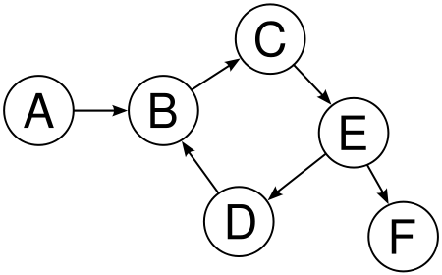
A,B,C, E,D,F
AB, BC, CE, ED,EF

Slide 9
BFS
Program
BFS.docx

